Slide 1
Effects of My Tiktok Usage on My Daily Activities
Bahar Sayınalp 32296

Slide 2


My Data Set

Slide 3
My Data Set
The data includes:
Details of login history and browsing activity over a 6-month period. (June 2024-December 2024)
Favorited videos over a 3 year period. (November 2021- November 2024)
Daily goodnotes usage over a month period (November 2024)

Slide 4
Aim and Hypotheses
Aim: Analyzing my overall Tiktok activity and exploring the correlation between my TikTok usage and other daily activities with respect to time and productivity levels.
Hypothesis 1: My tiktok usage correlates with the hour of the day.
Hypothesis 2: My tiktok login frequency increases during the weekends.
Hypothesis 3: Increased TikTok login frequency correlates with decreased GoodNotes usage.

Slide 5
Hypothesis 1:
First I explored my favorited videos during the 3 year period because my raw tiktok data only provided the amount of videos I favorited from November 2021 to November 2024 and at what time I favorited them.
After extracting the favorited videos from the data, I sorted them into a csv file for better analyzing.
I assumed number of favorited videos aligns with the number of videos I watch during the day, so I decided to see the correlation between the total videos I favorited and the hour of the day to check if my tiktok daily activity is affected by the time of day.

Slide 6
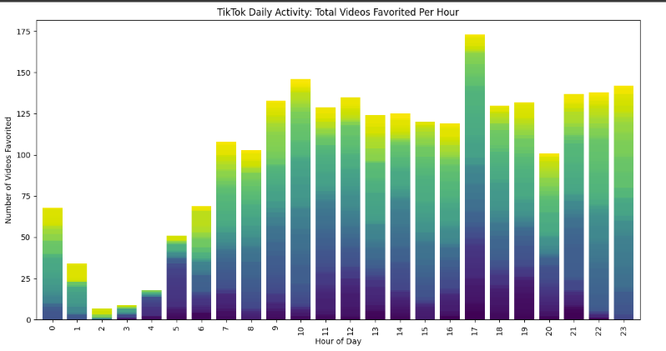
Hypothesis 1:
The colors represent the years. The year goes up as the color lightens.

Slide 7
Hypothesis 1:
From the graph, I calculated:
Pearson Correlation Coefficient: 0.77
P-Value: 0.00001
These indicate a strong positive correlation between the hour of the day and number of favorited videos. As the hour increases (e.g., moving from early morning to evening), the number of videos favorited tends to increase.
Thus, we fail to reject the Hypothesis 1.

Slide 8
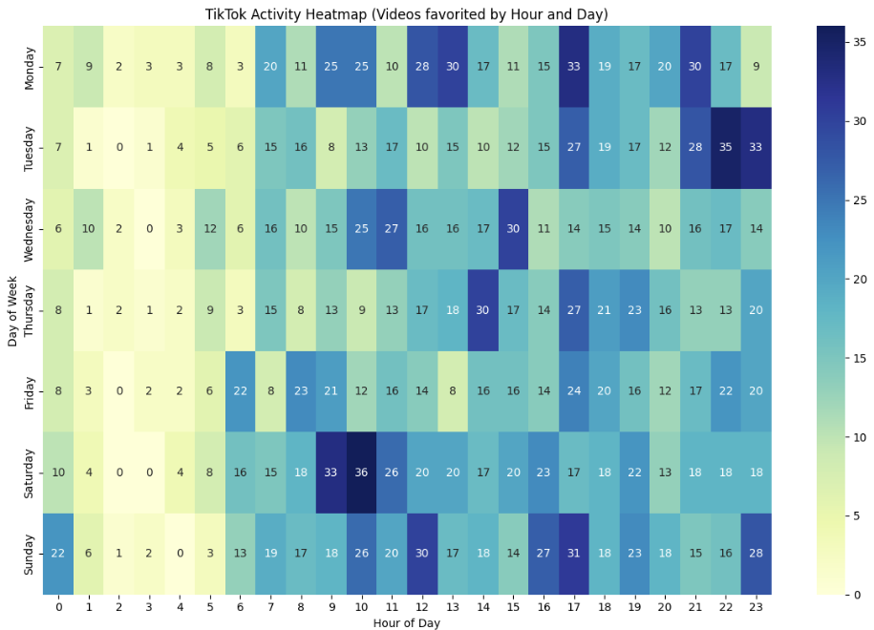
I explored the data further by creating a heatmap.
We can also see that there is a significant correlation since the color darkens as the hour increases.

Slide 9
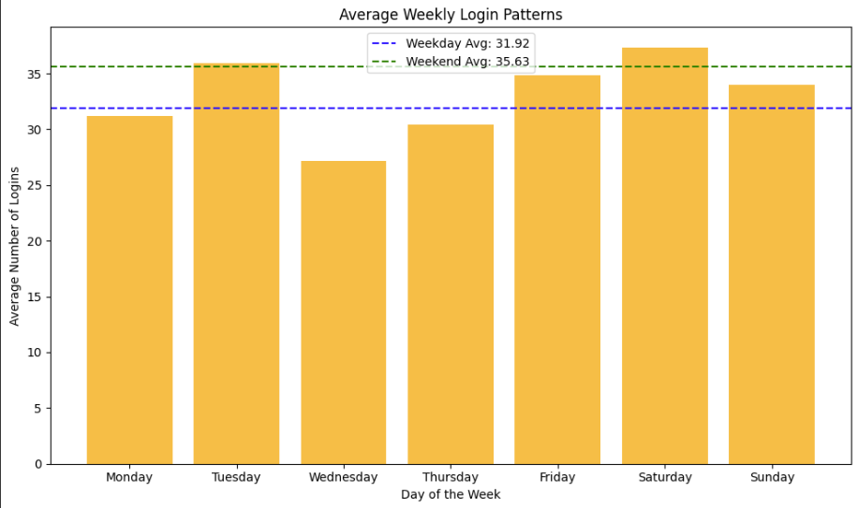
Hypothesis 2:
I analyzed my login history from June 2024 to December 2024. I extracted the amount of my logins on each day from the data and put them into a csv file.
After, I calculated my average number of logins for each day. To test the hypothesis, I calculated the difference between weekdays and weekends respect to average number of logins.

Slide 10
Hypothesis 2:
According to the chart, we can see a slight difference between amount of logins during weekdays and weekends. However, the difference in login frequencies between weekdays and weekends is not statistically significant due to p-value (0.234) being greater than 0.05 (common threshold).
Thus, we fail to reject this hypothesis since we don’t have the sufficient evidence.

Slide 11
Hypothesis 3:
For the third hypothesis, I recorded my daily GoodNotes App activity through the month November 2024 by apples health app and put the datas into an excel file. I always use this app for studying so I analyzed whether Tiktok usage decreases productivity levels by decreasing my GoodNotes usage.
To test this, I calculated how many videos I watched daily in November, which I extracted from the raw TikTok data file. Then I created a scatter plot to check the correlation. I did the same thing for the login history as well.

Slide 12
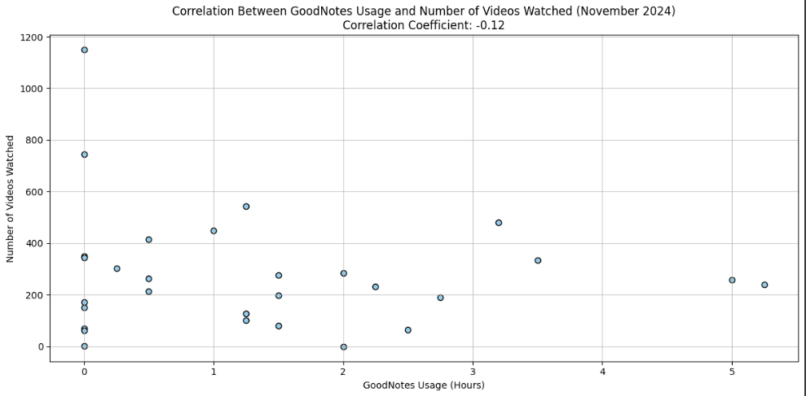

Slide 13
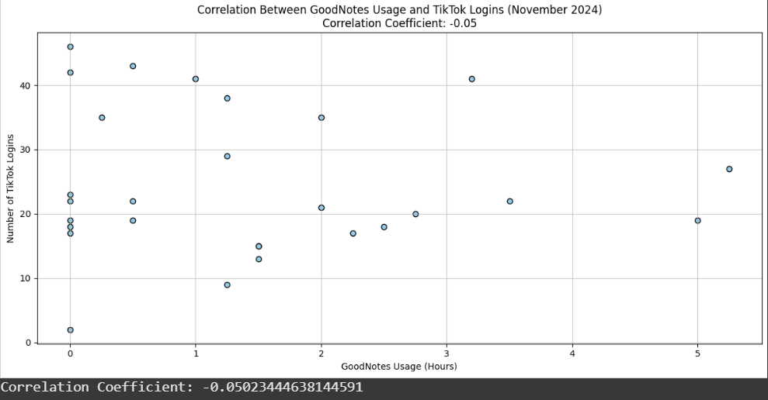
Both correlations are negative and very close to zero. We can conclude that there is a very weak correlation between my TikTok usage and productivity levels, indicating they are most likely to be independent. Thus, we reject the hypothesis 3.

Slide 14
Thank You.

